Slide 1
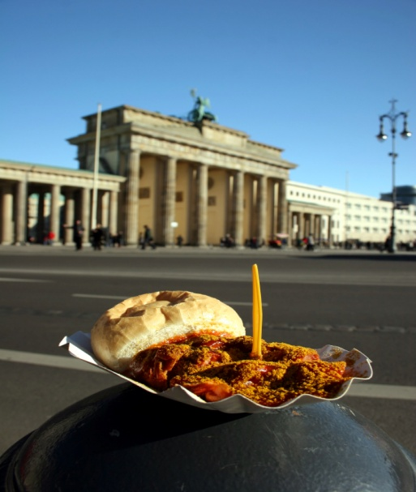
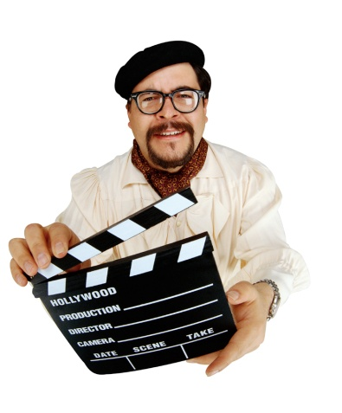
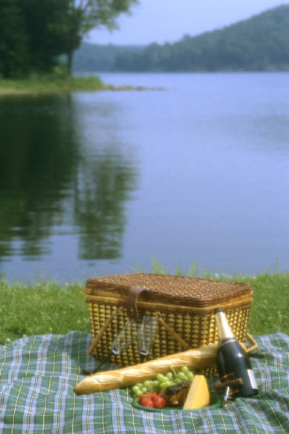
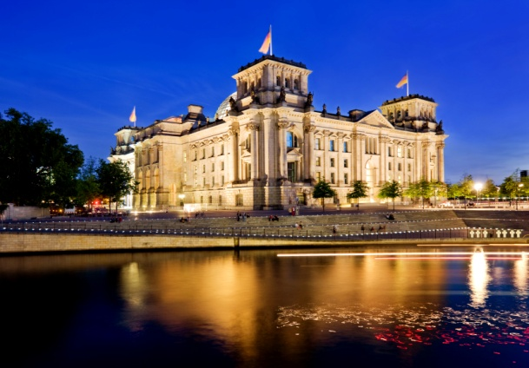
Was machst du?
Das Perfekte Date

Slide 2
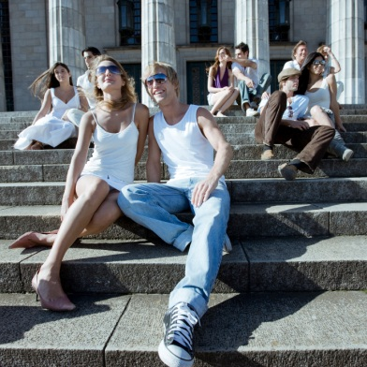
Introduction
You just moved to Berlin. You ,Zara, Sabine, Daniel, and Marco from the Deutsch Aktuell video are friends now.
You know that Marco and Zara are dating. However, we all know that Marco is not a great boyfriend. Zara is really upset with him.
Marco wants to make it up to Zara and he asks you to help him. He wants a perfect date with her. Of course he does not know what it takes. You are in charge!!! You are his event planner.
Create a perfect date for Marco and Zara. What would do you think she would like to do? A dinner or a picnic? A movie or a trip to the shopping center, a day at a museum, or sightseeing? Remember that Marco is not perfect, but he is trying. He might not like your ideas.
This is a great opportunity to show your leadership, planning, problem-solving, and technology skills. The journey through the web quest allows you to review German vocabulary for clothing, gifts, food, weather, free-time activities, directions historical and cultural facts of Germany’s, capital, Berlin.
Will Zara forgive him?

Slide 3
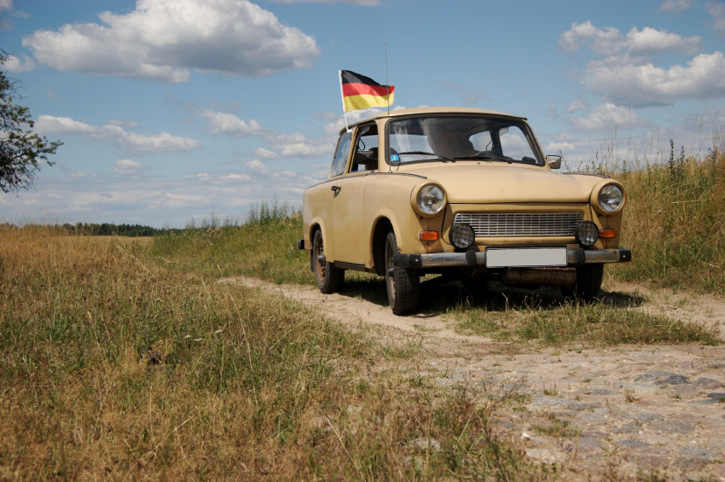

Task
German I and German II
You will use the Internet to brainstorm and decide on activities that Marco and Zera can do on their date.
Make a list of at least three activities and details needed to have a successful date.
Create a time line in PowerPoint with details of the proposed date. Plan for the whole day! (Example: 9 Uhr bis 10 Uhr Brandenburger Tor besichtigen)
You also need to provide Marco with the detailed costs, weather, and the needed items of the date (Jacket, comfortable shoes, umbrella, food, picnic basket
You will need to answer blog questions in German posted on my website http://frauchalkley.weebly.com or on Facebook Frau Chalkleys Deutschklassen in the discussion forum. You will receive participation credit for answering two questions.
You will e-mail the final report to Marco (me) ulrike.chalkley@eu.dodea.edu or submit it through my website http://frauchalkley.weebly.com on the Web Quest page. (It will be a test grade)

Slide 4

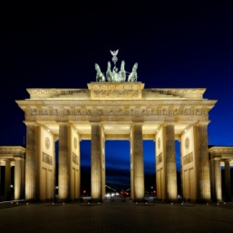
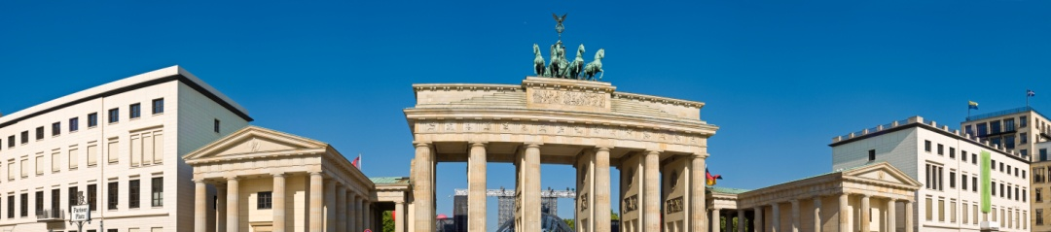
Process
Step 1 Get some ideas
Watch the movies about tourists in Berlin. It will help you to give you ideas about activities and famous sites.
Visit Berlin Video 1
Visit Berlin Video 2
Step 2 Brainstorm
You and a partner/s will brainstorm the main details of the date. Use the graphic organizer and start the first activity before you do the research. Continue using the worksheet to record the rest of the information on the worksheet. PlanningWorksheet.doc
Check out the website with attractions in Berlin. It might help you to complete or make changes to your list.
Attractions
Step 3 Research
Find the information on the 3 different activities on the Internet and record the details (cost, opening hours, address and telephone number, make
predictions on how to dress for the events or activities and necessary items needed)
Events
Sports
Activities

Slide 5

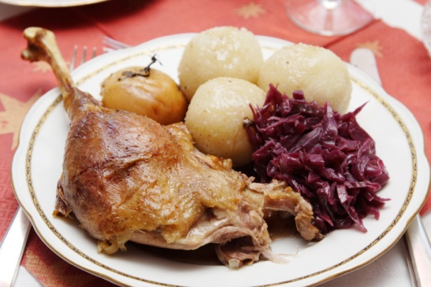
Process
Step 4 Weather report
Check the weather for that day. Going to an outdoor pool or playing Putt Putt golf is
not fun in the rain. Record the weather for that day and include a weather map.
Weather
Step 5 Items needed
Marco needs some new clothes and some other items that he needs for the date (picnic basket, hiking boots, etc.) .
Shopping
Outlets
Step 6 Food
Make sure to include at least one nice meal. Research the restaurants and then access the menu for that restaurant. Suggest a meal (include drink and dessert) and record the price. Remember, Zera is turkish and does not eat pork!!!!
Restaurants (select the type of restaurant, cuisine, and location)
You may play games if you are done!
Game-Places
Game-Attraction Words
Game-History

Slide 6

Process
Step 7 Presentation
Update your information on the worksheet and create
A one to three page PowerPoint presentation to show to Marco (me) for approval of the perfect date.
List at least three activities including the time, the materials/items needed, and the approximate cost in German (use Euros as currency)
Include pictures of the restaurant, attractions, a city map with the locations marked, and the weather conditions (can be icons or a weather map for that day (use Celsius not Fahrenheit)
Do not forget to cite all your sources including pictures.
E-mail or submit the presentation to Marco (me) no later than June 13th ) http://frauchalkley.weebly.com or ulrike.chalkley@eu.dodea.edu
City Photos
City Map

Slide 7
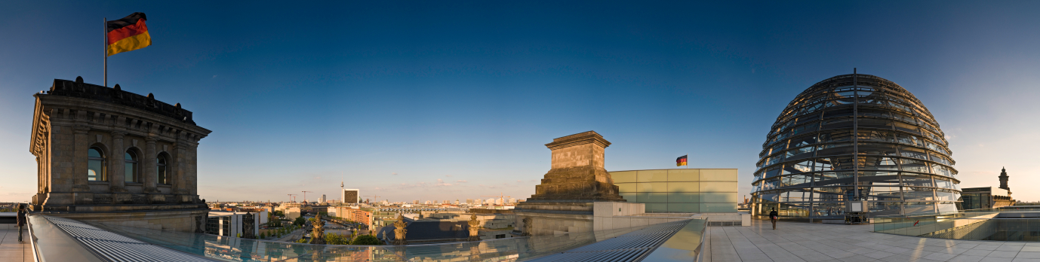
Evaluation
Please use the following rubric to help you complete the presentation. Play close attention to the details. This will be a test grade. Make sure to evaluate yourself and then submit the presentation with the rubric. If you are working in groups, include the name/s of your group members. Don’t forget to attach and send it with your presentation.
RubricPowerPoint1.doc

Slide 8
Teacher Page
Introduction
This web quest is designed to help students understand what is involved in organizing activities in a typical German city using technology. In addition to learning how to navigate German websites, the students can identify and learn some of the historical facts and cultural differences between Germany and the US by organizing cultural and historical significant activities. Furthermore, the students review vocabulary and expressions learned in German I by preparing the presentation in German.
Cross-curricular and technology emphasis
This web quest was intended for a student-centered learning activity with an emphasis on technology. Although the web quest is created for students of German I and German II, it can also be used to reinforce skills in social studies (Culture, climate, and cities of European countries), and math (Estimation, percentage, currency conversion, metric system).

Slide 9
Teacher Page
Lesson modification and extension
Some links on this web quest are in English. Most websites can be changed to the German website by using .de instead .com at the end of the web address. German II students are encouraged to use only the German websites and use websites outside of this web quest.
The final report is presented in German in class. Peers are encouraged to give feedback.
Although the web quest is designed for individual research, the activities can be completed in groups of four (1. Budget; 2. Activities; 3. Details- Weather, Clothing and other items; 4. Presentation- Pictures, graphic, advanced features, citations).
Questions for further study
1. What influenced your choice of activities for the perfect date?
2. How would you set up a perfect date in the United States?
3. Have you noticed some differences between the activities available to German and American
teenagers. How are they different? How are they the same?

Slide 10
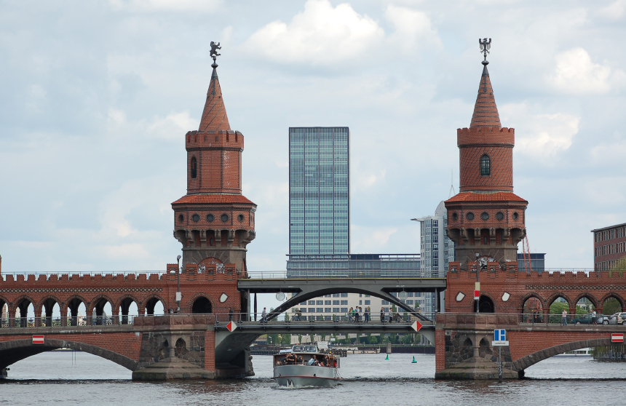
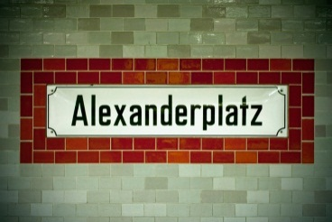
Standards of Foreign Language
FL1 Communication Interpretive mode focuses on the understanding and
interpretation of written and spoken language. It involves one-way listening and reading in which
the reader works with a variety of print and non-print materials.
FL1 Communication Presentational mode involves communication of information, and
focuses on concepts, and ideas in spoken and written modes. It is concerned with one-way
speaking and writing.
FL2 Culture The Culture strand focuses on understanding the perspectives (attitudes,
values), the practices (patterns of social interactions), and the products (e.g., food, books, games, etc,) of a society. It is important that students become skilled observers and analysts of other cultures.
FL3 Connections The Connections strand focuses on reinforcing and expanding
knowledge of other disciplines through the target language. The conscious effort to connect the
target language curriculum with other parts of students’ academic lives opens doors to
information and experiences which that enrich the students’ entire school and life experiences.
FL4 Comparisons The Comparisons strand focuses on gaining insight into the nature
of language, linguistic, and grammatical concepts, and the communicative functions of language
in society, as well as the complexity of the interaction between language and culture. The
understandings gained about the nature of language and its interaction with culture carry over

